Slide 1

Abnormality Detection in Musculoskeletal Radiographs
Divya Shankar | Sabrina Sok Snigdha Jain

Slide 2
Introduction to MURA
Musculoskeletal Radiographs (MURA)
Musculoskeletal conditions affect more than 1.7 billion people worldwide
Most common cause of severe, long-term pain and disability, with 30 million emergency department visits annually and increasing.
Bone X-Rays are used to detect these musculoskeletal conditions.
Large dataset of Bone X-rays
Problem Statement
Classify X-Rays from MURA dataset into:
Normal
Abnormal

Slide 3
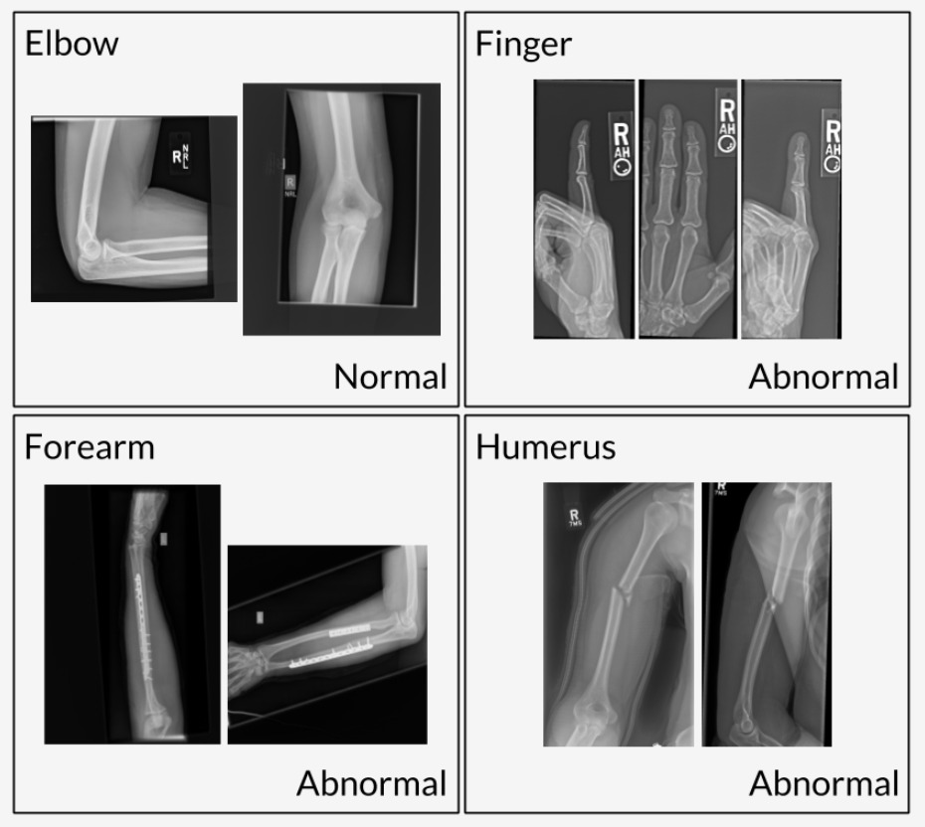
Data Description
Dataset is created by Stanford.
Consists of 14,863 studies from 12,173 patients, with a total of 40,561 multi-view radiographic images.
Body parts covered: elbow, finger, forearm, hand, humerus, shoulder, and wrist.
Study manually labeled as normal or abnormal
Image dimensions ~ 512*512

Slide 4
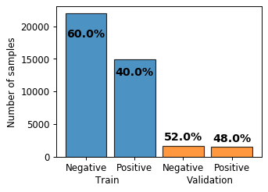
Distribution of Data

Slide 5
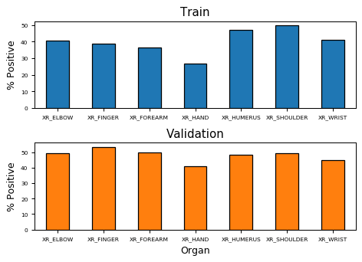
Distribution of Data

Slide 6
Project Approach
Image Preprocessing:
Images resized to 224*224 OR 300*300
ImageDataGenerator & flow_from_directory used to generate a batch of augmented/normalized data
Models Trained:
Simple CNN
Complex CNN
Transfer Learning: MobileNet
Comparison of Models based on Accuracy

Slide 7
Simple Model Architecture
flattened
Dropout 0.5
Conv2D, 32
ReLU
Maxpooling2D
Conv2D, 32
ReLU
Maxpooling2D
Conv2D, 64
ReLU
Maxpooling2D
Dense, 64
ReLU
Dense, 1
Sigmoid
Total params: 5,943,393
Output = (0, 1)
Notes:
We started by creating a simple model. In this model we have a total of 5 layers.
The first 4 layers have activation ReLU whereas the last layer had the Sigmoid function to predict an output of 0 or 1. We included MaxPooling to extract the most important features. We also added a dropout regulization of 0.5 so that network becomes less sensitive to the specific weights of neurons, and to reduce the likelihood of overtraining the train data.

Slide 8
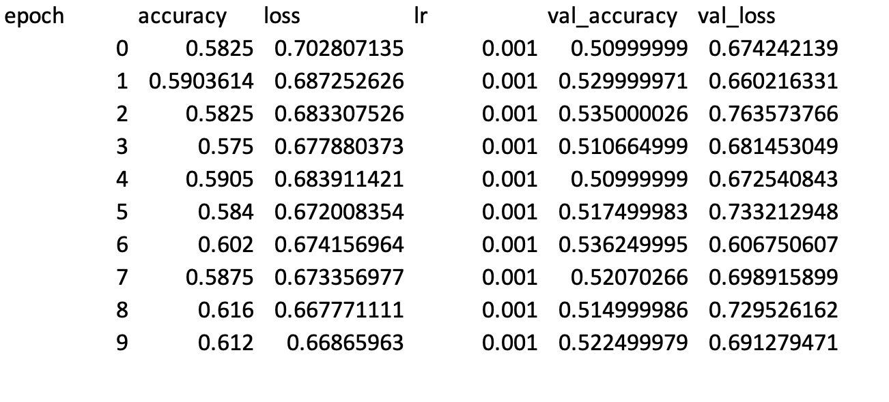
Simple Model Metrics

Slide 9
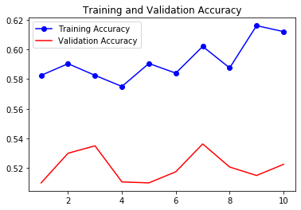
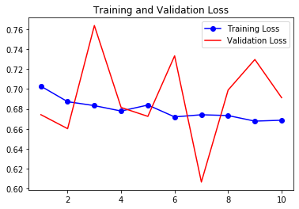
Simple Model Accuracy & Loss

Slide 10
Complex Model
Conv2D, 32, ReLU
Batch Normalization
Conv2D, 32, ReLU
Batch Normalization
MaxPooling2D
Conv2D, 64, ReLU
Batch Normalization
Conv2D, 64, ReLU
Batch Normalization
MaxPooling2D
Conv2D, 128, ReLU
Batch Normalization
Conv2D, 128, ReLU
Batch Normalization
MaxPooling2D
Conv2D, 512, ReLU
Batch Normalization
Conv2D, 512, ReLU
Batch Normalization
Conv2D, 512, ReLU
Batch Normalization
MaxPooling2D
Conv2D, 512, ReLU
Batch Normalization
Conv2D, 256, ReLU
Batch Normalization
MaxPooling2D
Conv2D, 256, ReLU
Batch Normalization

Slide 11
Complex Model
Conv2D, 512, ReLU
Batch Normalization
Conv2D, 256, ReLU
Batch Normalization
Conv2D, 128, ReLU
Batch Normalization
Conv2D, 64, ReLU
Batch Normalization
Conv2D, 32, ReLU
Batch Normalization
Conv2D, 16, ReLU
Batch Normalization
Dense, 1, Sigmoid
Batch Normalization
Dense, 512, ReLU
Batch Normalization
Dense, 1024, ReLU
Batch Normalization
Dense, 1024, ReLU
Batch Normalization
GlobalAveragePooling2D
Conv2D, 256, ReLU
Batch Normalization
Total params: 14,982,097

Slide 12
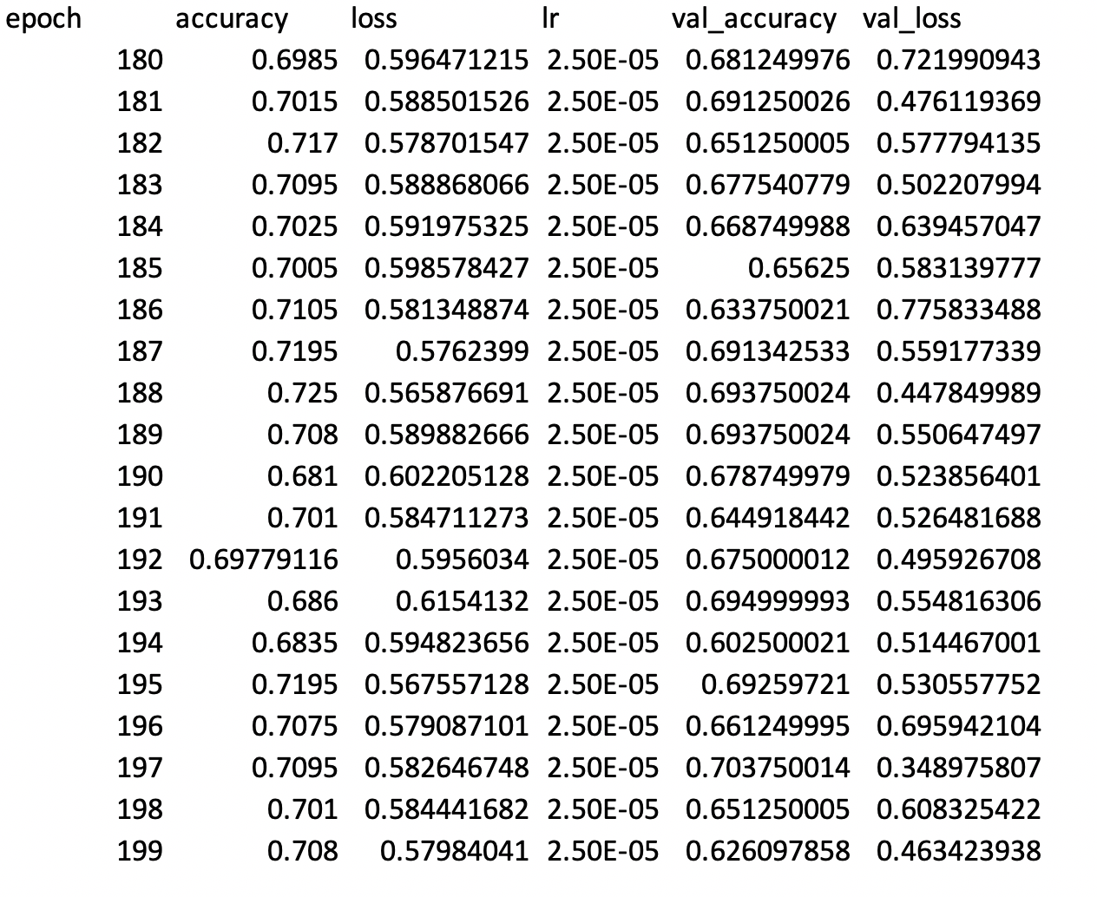
Complex Model

Slide 13
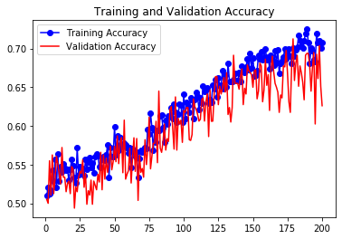
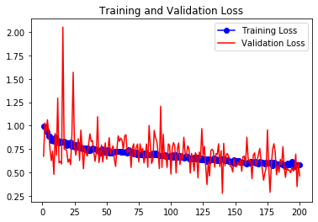
Complex Model

Slide 14
MobileNet
def mobileNet():
model = keras.applications.mobilenet_v2.MobileNetV2(weights = 'imagenet',
include_top = False,input_shape = (224, 224, 3))
x = model.output
x = GlobalAveragePooling2D()(x)
preds = Dense(1, activation='sigmoid')(x)
model = Model(inputs=model.input, outputs=preds)
model.compile(loss='binary_crossentropy', optimizer='Adam', metrics=['accuracy'])
return model
Total params: 2,259,265

Slide 15
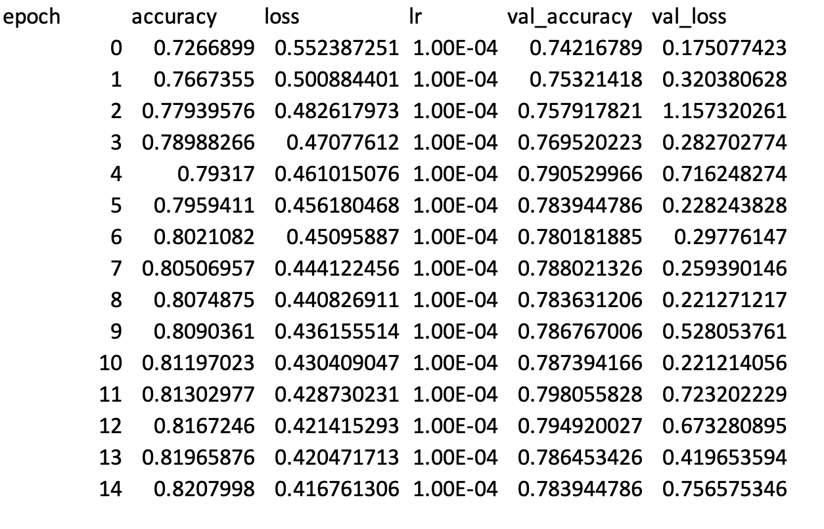
MobileNet Metrics

Slide 16
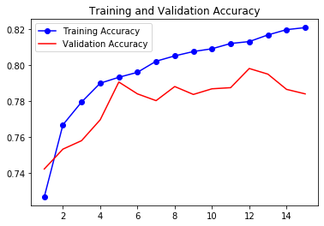
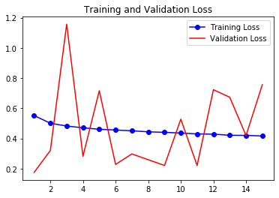
MobileNet Accuracy & Loss

Slide 17
Comparison of Models
Model/Metric | Accuracy | Loss
Simple CNN | ~61% | ~67%
Complex CNN | ~71% | ~58%
MobileNet | ~82% | ~41%

Slide 18
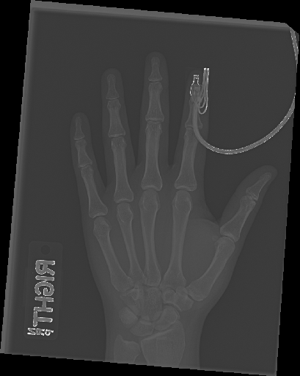
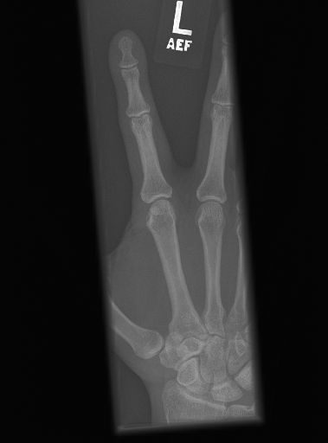
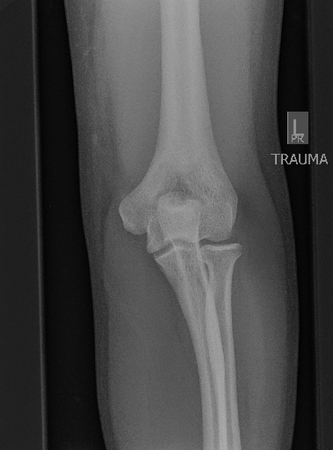
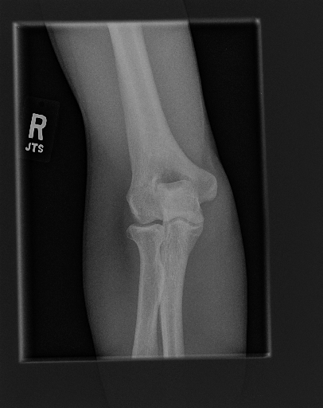
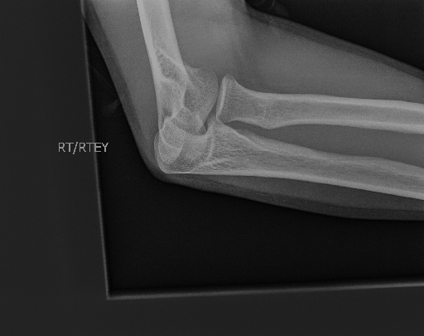
Prediction
Wrong Prediction: Predicted as Abnormal
Right Prediction: Predicted as Abnormal

Slide 19
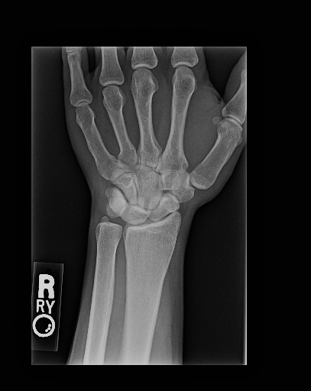
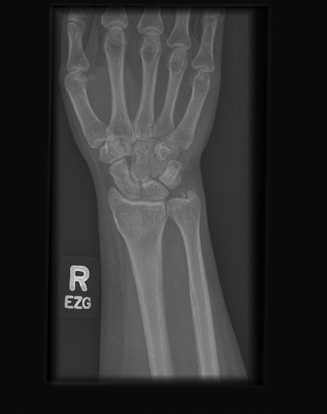
Conclusion
Abnormal
Normal
Notes:
Abnormal - predicted right by model
Normal - predicted wrong by model

Slide 20
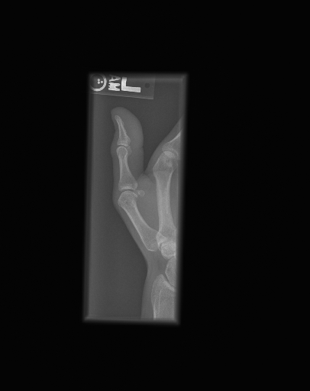
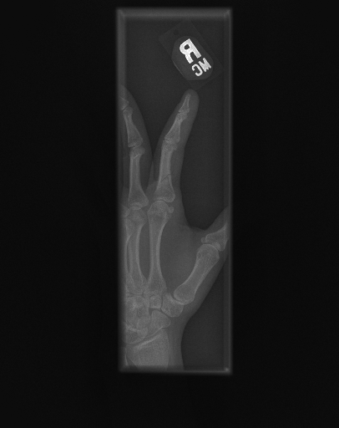
Conclusion
Normal
Abnormal
Notes:
Abnormal - predicted right by model
Normal - predicted wrong by model

Slide 21
Future Work
Improve model accuracy
Extensive Hyperparameter tuning
Implement regularization to avoid overfitting
Deployment of solution on cloud platforms
Development of a front-end application

Slide 22
Thank You!

Slide 23
References
MURA Dataset: https://stanfordmlgroup.github.io/competitions/mura/
Keras Documentation: https://keras.io
Notes:
Why average pooling and not max pooling. Average pooling sometimes can’t extract good features because it takes all into count and results an average value which may/may not be important for object detection type tasks.

